Slide 1
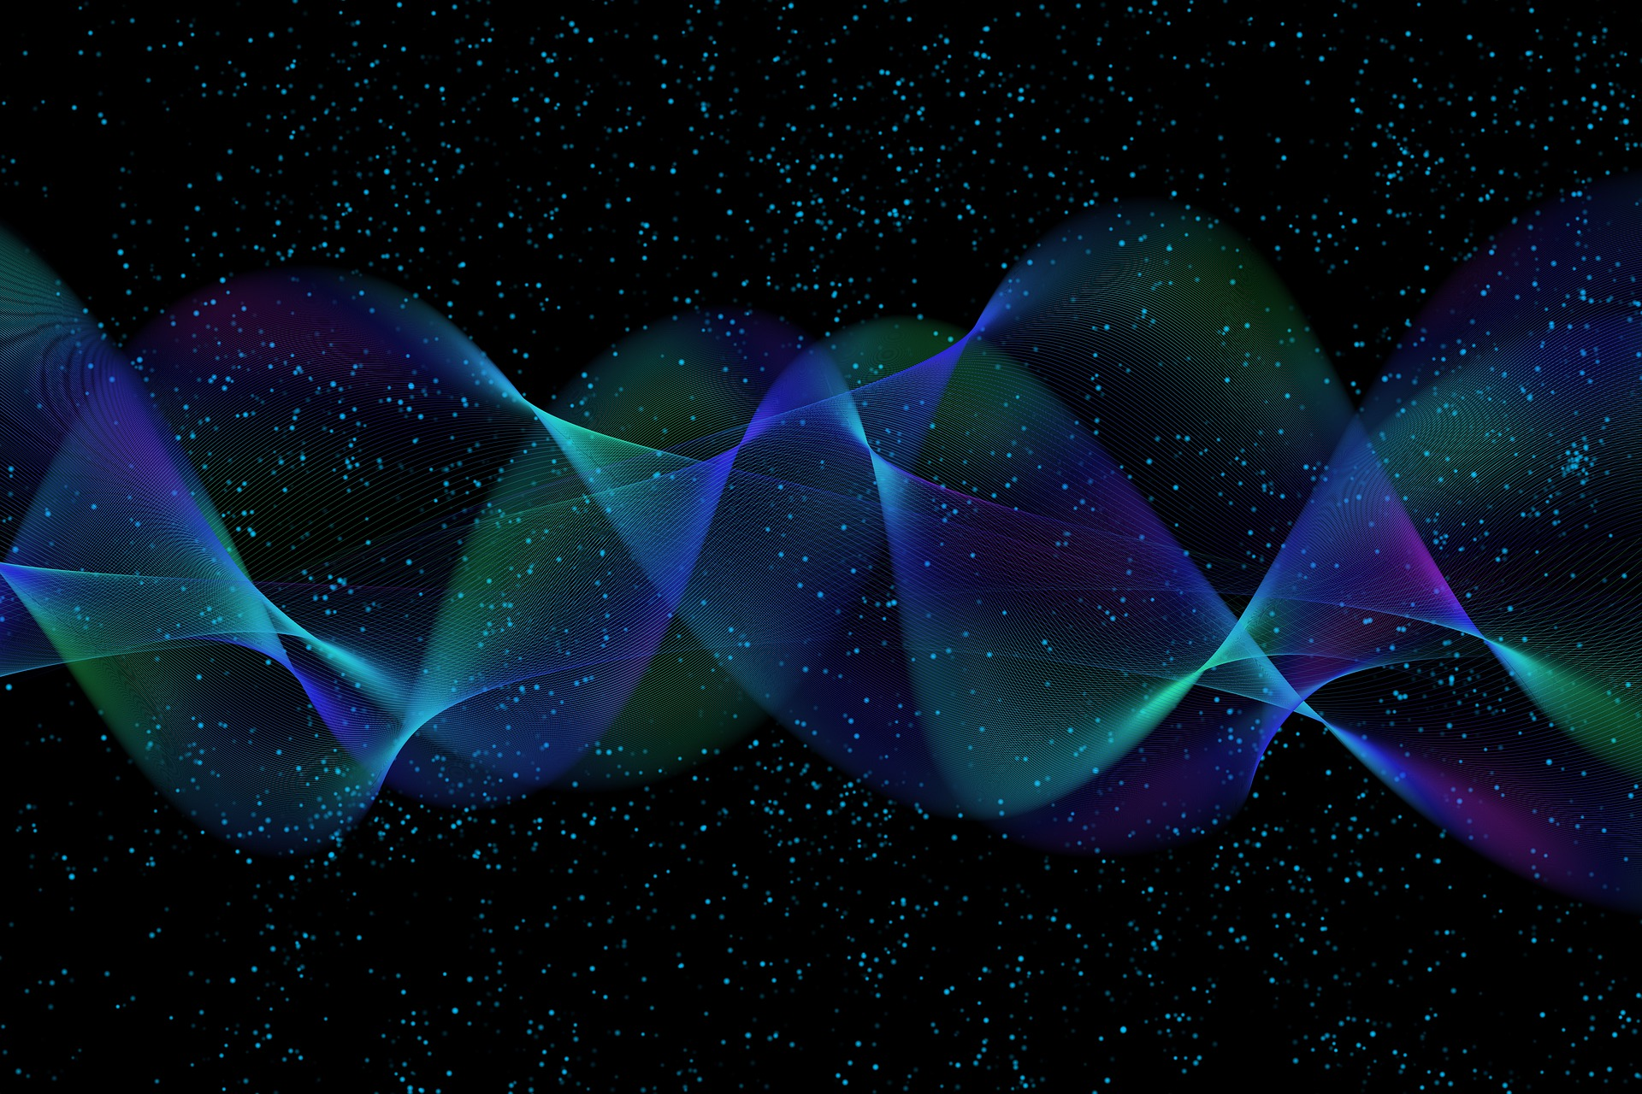
Quantum Computing
11. Quantum Machine Learning
& Quantum AI
Quantum Computing Insitute
https://qcict.org
Prof. Aleksandar Radovanovic
alex@qcict.org

Slide 2
A Brief History of AI and Machine Learning
1956
1980s
Artificial Intelligence
Neural Networks
Advances in neural networks lay the foundations for deep learning.
2009
HHL Algorithm
Dartmouth workshop helps establish AI as a field of research..
1990s
Early Quantum Machine Learning
Chrisley and Kak propose early quantum neural networks.
Harrow, Hassidim, and Lloyd demonstrate quantum speedup for certain linear algebra problems..
2010s
Deep Learning Breakthrough
Major advances in image recognition, natural language processing, and machine translation.
Dartmouth 1956.
Notes:
History of AI and Machine Learning
The history of artificial intelligence is often traced back to the Dartmouth Summer Research Project in 1956, which helped establish AI as a distinct field of research.
After early excitement, AI experienced periods of reduced interest and funding in the 1970s and again in the late 1980s, known as the AI winters.
Neural networks had been studied since the 1950s and 1960s, with important advances in backpropagation during the 1980s. The major breakthrough came after 2010, when increased computing power and large datasets enabled deep learning to achieve major successes in image recognition, speech processing, and machine translation.
Rise of Quantum Machine Learning
Early ideas combining quantum computing and learning appeared in the 1990s, including work by Chrisley and Subhash Kak.
A major milestone came in 2009, when Harrow, Hassidim, and Lloyd introduced the HHL algorithm, demonstrating exponential speedup for certain linear algebra problems under specific conditions. Since linear algebra is fundamental to machine learning, this result helped drive the development of modern quantum machine learning (QML).
Reference:
Chrisley, R. (1995). Quantum Learning. In P. Pyllkkänen & P. Pyllkkö (Eds.), New Directions in Cognitive Science. Finnish Society for Artificial Intelligence.
Kak, S. C. (1995). On Quantum Neural Computing. Inf. Sci., 83, 143–160. https://api.semanticscholar.org/CorpusID:7498355

Slide 3

Defining AI, Machine Learning, and Quantum AI
Artificial Intelligence is the science and engineering of making intelligent machines.
John McCarthy 1955
Machine learning is a field of study that gives computers the ability to learn without being explicitly programmed.
Arthur Samuel (1959)
Quantum artificial intelligence (QAI) is a research field focused on developing artificial intelligence and machine learning methods that use the power of quantum computing.
Notes:
Two American researchers provided some of the most widely cited definitions of artificial intelligence and machine learning.
John McCarthy, who coined the term artificial intelligence, defined it as “the science and engineering of making intelligent machines.”
Machine learning, a subfield of artificial intelligence, was famously described by Arthur Samuel as “a field of study that gives computers the ability to learn without being explicitly programmed.”
Extending these ideas, quantum artificial intelligence can be described as a research field focused on developing artificial intelligence and machine learning methods that use the power of quantum computing.
It is important to emphasize that quantum machine learning is not simply classical machine learning running on a quantum computer. It develops models and methods that use specifically quantum properties and operations as part of the learning process.

Slide 4
Artificial Intelligence, Machine Learning, and Deep Learning
ARTIFICIAL INTELLIGENCE
(Performs intelligent tasks)
MACHINE LEARNING
(Learns from data)
DEEP LEARNING
(Neural networks)
Notes:
Artificial intelligence (AI) is a broad field focused on creating intelligent systems that can perceive, reason, learn, and act to achieve a goal.
Machine Learning (ML) is a subset of AI that enables systems to learn patterns from data and make predictions or decisions without being explicitly programmed for every task.
Deep Learning (DL) is a specialized subfield of ML that uses multi-layered artificial neural networks to automatically learn complex representations of data, excelling at tasks such as image recognition and natural language processing.

Slide 5
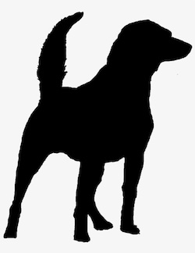





Learning From Data
class=?
training data
training
algorithm
model
cat
cat
dog
dog
inference
engine
classes= {cat, dog}
Machine learning is learning from existing data and using that knowledge to make decisions about new data.
dog
Notes:
Machine learning is about learning from existing data and using that knowledge to make decisions about new data.
In a classification problem, the goal is to assign data to predefined classes. For example, to classify an image as either a cat or a dog.
The process begins with a set of examples for which the correct classes are already known. This is called the training data. A machine learning program uses this data to identify patterns and build a model. Once training is complete, the model can be saved and reused later.
When new, unseen data is provided, another part of the system, often called the inference engine, loads the trained model and uses it to make a classification.

Slide 6
Types of Machine Learning
Machine Learning
Supervised
Unsupervised
Reinforcement
labeled data
unlabeled data
trial and error
cat
cat
dog
dog
Notes:
Machine learning is typically divided into three main types: supervised, unsupervised, and reinforcement learning.
Supervised learning learns from labeled training data and uses the resulting model to classify or predict new data. Besides classification, it includes regression, which predicts continuous numerical values. For example, predicting a house price from historical sales data.
Unsupervised learning works with unlabeled data and tries to discover hidden patterns or groups. For example, given images of apples and watermelons without labels, the algorithm may group them based on properties such as color, shape, and size.
Reinforcement learning learns through trial and error by interacting with an environment and receiving rewards or penalties. For example, a Pac-Man agent can learn to collect rewards while avoiding ghosts. Similar principles can be applied to autonomous systems that learn which actions lead to better outcomes.

Slide 7
Discriminative and Generative Models
Machine learning
discriminative
generative
Learn to distinguish.
Learn to create.
Model
Model
cat
Notes:
A common distinction in modern machine learning is between discriminative and generative models.
Discriminative models learn to distinguish between different outcomes or make predictions from input data. For example, a discriminative model can learn whether an image represents a cat or a dog.
Generative models learn the underlying probability distribution of the data. This allows them not only to recognize patterns in the data but also to generate new, similar samples.

Slide 8
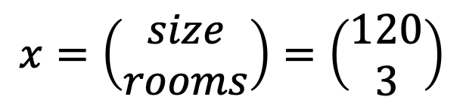
Key Concepts: Data, Attributes, and Features
features
$$x=\left(\begin{matrix}size \\ rooms\end{matrix}\right)=\left(\begin{matrix}120 \\ 3\end{matrix}\right)$$
datatset = 3 data points
2D feature vector
Data: Facts or measurements (e.g., floor size = 100 m², rooms = 2)
Data point: One example in the dataset (e.g., one house: 120 m², 3 rooms)
Attribute: A property of the data as originally collected (e.g., size in square meters)
Feature: An attribute selected or transformed for use in a model (e.g., normalized size)
Feature vector: Set of features describing one data point (e.g., [x1​,x2​])
Feature space: The n-dimensional space defined by the features (2 features → 2D space)
Dataset: The complete collection of data points used for training and testing a model.
Notes:
In machine learning, data are organized into data points, described by attributes that can be selected or transformed into features. These features form feature vectors within a feature space.
Data are collected facts or measurements.
Data point is a single observation or example in a dataset.
Attribute is a property of a data point as originally collected, for example, the size of a house in square meters.
Feature is an attribute that has been selected or transformed for use as input to a machine learning model. Features are often normalized to make them suitable for processing.
Feature vector is the set of features describing a single data point, commonly represented mathematically as a column vector.
Feature space is the multidimensional space defined by all features, with one dimension for each feature.
Dataset is the complete collection of data points used for training, validation, or testing.
Data preparation
Data preparation commonly includes two important processes:
Feature selection – Choosing the attributes that are most relevant to the problem. For example, floor size may be useful for predicting house prices, while house color may be less relevant.
Feature engineering – Transforming raw attributes into a form that can be effectively processed by the model. Numerical values can be used directly or normalized, while categorical information, such as a street name, can be converted using one-hot encoding.
Quantum data encoding – Encoding numerical feature values into quantum states so they can be processed by a quantum circuit.

Slide 9
Quantum Machine Learning by Data and Algorithm Type
algorithm type
classical
quantum
CC
CQ
classical
data type
QC
QQ
quantum
https://commons.wikimedia.org/wiki/File:Qml_approaches.tif?page=1
Notes:
In quantum machine learning, different approaches can be categorized according to the type of data (classical or quantum) and the type of algorithm (classical or quantum).
The first letter in the diagram indicates whether the data is classical (C) or quantum (Q), while the second letter indicates whether the algorithm is classical or quantum. This gives four possible workflows:
CC (Classical–Classical): Standard machine learning — classical data processed by classical algorithms.
CQ (Classical–Quantum): Classical data encoded into quantum states and processed by a quantum algorithm.
QC (Quantum–Classical): Quantum data measured and then processed by a classical algorithm. Measurement converts the quantum information into classical data and may lose some information about the original quantum state.
QQ (Quantum–Quantum): Quantum data processed directly by quantum algorithms. This can include quantum data produced by quantum sensors, communication systems, or quantum simulations.

Slide 10
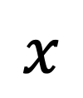
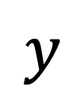
Three-step QML Model
quantum computer
processing
measurement
encoding
Input data
prediction
$$x$$
$$y$$
Schuld, M.: Quantum machine learning models are kernel methods (2021). arXiv preprint arXiv:2101.11020
Notes:
Quantum machine learning can be described using a general three-step model:
Data encoding – Input data is encoded into quantum states using methods such as basis encoding, amplitude encoding, or angle encoding.
Quantum processing – A quantum circuit processes the encoded data and acts as the machine learning model. The circuit may contain tunable parameters that are optimized during training, often using a classical optimization loop.
Measurement and prediction – Finally, the quantum state is measured. The measurement results are converted into classical information and interpreted as the output or prediction of the model.
Reference
Schuld, M., Supervised quantum machine learning models are kernel methods (2021). arXiv preprint arXiv:2101.11020

Slide 11
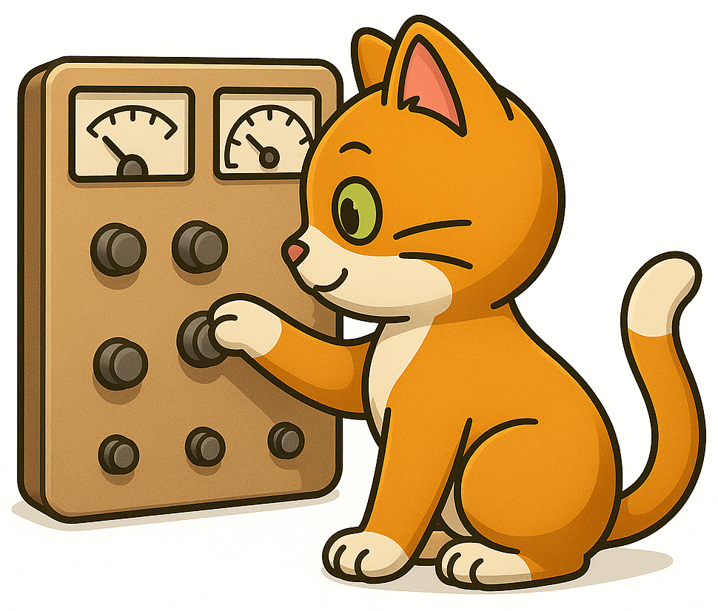
Variational quantum
algorithms (VQAs)
Notes:
Variational Quantum Algorithms (VQAs) are hybrid quantum–classical methods used in optimization, machine learning, and quantum chemistry.
They use variational (parameterized) quantum circuits with tunable gates.
A classical optimizer adjusts these parameters to minimize or maximize a cost function, using feedback from quantum measurements.
The quantum circuit efficiently explores the solution space, while the classical optimizer steers the search toward the best solution.

Slide 12


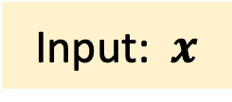
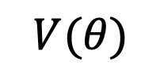
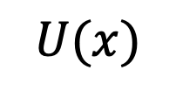


Variational Quantum Model
Input: $x$
$$θ_{0}$$
$$\left|0\right\rangle$$
cost
optimize
$$U(x)$$
$$V(θ)$$
$$\left|0\right\rangle$$
ansatz
encoding
layer
variational
layer
measure
$$θ$$
Notes:
Variational or parameterized means that the quantum circuit contains adjustable parameters, typically the rotation angles of certain quantum gates, which are tuned during training.
Such a circuit is called a Variational Quantum Circuit (VQC) or Parameterized Quantum Circuit (PQC) and can be viewed as a quantum counterpart of a trainable machine learning model.
A VQC typically consists of three layers:
Encoding layer $U(x)$: Encodes the classical input features $x$ into a quantum state using methods such as basis, amplitude, or angle encoding.
Variational layer $V(θ)$: Contains parameterized quantum gates whose parameters θ are adjusted during training. The structure of this layer is often called an ansatz—an assumed circuit structure that can be tuned to approximate the desired solution.
Measurement layer Selected qubits are measured to obtain classical output from the quantum circuit. The circuit is typically executed many times (shots) to estimate probabilities or expectation values.
Training Loop
Start with input data $x$ and initial parameters θ.
Execute the quantum circuit and measure its output.
Compare the output with the expected result and calculate a cost (loss) function.
A classical optimizer uses the cost to update θ.
Run the circuit again with the new parameters and repeat until the model reaches the desired performance.

Slide 13

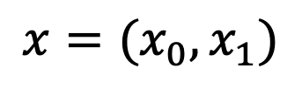

















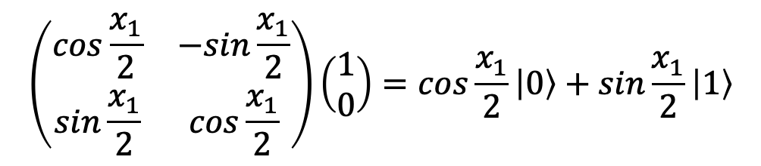


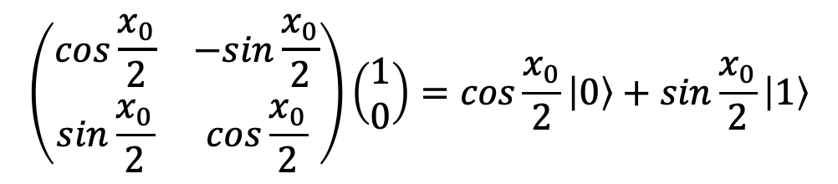




Angle Encoding
$$\left|0\right\rangle$$
$$⋮$$
$$U(x)$$
$$V(θ)$$
$$M$$
$$O$$
$$z$$
$$\left|0\right\rangle$$
Real
plane
$$\left|0\right\rangle$$
$$x$$
$$x$$
$$x$$
$$y$$
$$x=(x_{0},x_{1})$$
$$q_{0}$$
$$q_{1}$$
$$x$$
$$\left|1\right\rangle$$
$$\left(\begin{matrix}\cos{\frac{x_{0}}{2}} & −sin{\frac{x_{0}}{2}} \\ \sin{\frac{x_{0}}{2}} & \cos{\frac{x_{0}}{2}}\end{matrix}\right)\left(\begin{matrix}1 \\ 0\end{matrix}\right)=\cos{\frac{x_{0}}{2}}\left|0\right\rangle +\sin{\frac{x_{0}}{2}}\left|1\right\rangle$$
$$q_{0}$$
$$\left|0\right\rangle$$
$$RY\left(x_{0}\right)$$
$$⨂$$
$$q_{1}$$
$$\left(\begin{matrix}\cos{\frac{x_{1}}{2}} & −sin{\frac{x_{1}}{2}} \\ \sin{\frac{x_{1}}{2}} & \cos{\frac{x_{1}}{2}}\end{matrix}\right)\left(\begin{matrix}1 \\ 0\end{matrix}\right)=\cos{\frac{x_{1}}{2}}\left|0\right\rangle +\sin{\frac{x_{1}}{2}}\left|1\right\rangle$$
$$\left|0\right\rangle$$
$$RY\left(x_{1}\right)$$
Notes:
The first step in many quantum machine learning algorithms is data encoding. One of the most common methods used with VQCs is angle encoding, where classical data values are encoded into the rotation angles of qubits.
Each component of a classical vector is typically normalized or scaled and then used as the rotation angle of a corresponding qubit, using gates such as RX​, RY​, or RZ​.
If the input vector has n components, a straightforward implementation uses n qubits, one for each feature.
Fewer qubits can also be used through techniques such as data re-uploading, where the same qubits are used to encode several data values at different stages of the circuit.
For example, a two-dimensional vector can be encoded using two qubits, with one rotation applied to each qubit. If RY​ rotations are used, the qubit states remain in the real x-z plane of the Bloch sphere. As a result, the corresponding state amplitudes remain real, which provides a simple way of representing real-valued input data.
The state of the complete register is obtained as the Kronecker product of the individual qubit states. If the encoding uses only independent single-qubit rotations, the resulting state is initially a product state; entanglement can then be introduced by subsequent layers of the VQC.

Slide 14

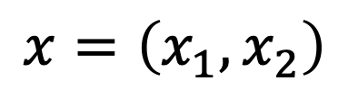




Higher-order Encoding
$$\left|0\right\rangle$$
$$⋮$$
$$U(x)$$
$$V(θ)$$
$$M$$
$$O$$
$$\left|0\right\rangle$$
$$x=\left(x_{1},x_{2}\right)$$
H
$$\left|0\right\rangle$$
$$RZ\left(x_{1}\right)$$
H
$$\left|0\right\rangle$$
$$RZ\left(x_{2}\right)$$
+
$$RZ\left(x_{1}x_{2}\right)$$
Havlíček and al. "Supervised learning with quantum-enhanced feature spaces", Nature volume 567, pages 209–212 (2019)
Notes:
Higher-order encoding extends angle encoding by introducing interactions between input features, allowing the quantum state to represent nonlinear relationships between them. In a straightforward implementation, one qubit is used for each component of the feature vector.
This example shows how to encode a two-dimensional feature vector $x=\left(x_{1},x_{2}\right)$.
The qubits are first placed into superposition.
Each qubit is then rotated about the Z-axis using the corresponding input feature, $x_{1}$​ or $x_{2}$​.
A CNOT gate introduces entanglement between the qubits.
An additional data-dependent rotation is applied with an angle proportional to the product $x_{1}x_{2}$​. The term $x_{1}x_{2}$​ captures an interaction between the two input features. Because the encoding includes such cross-terms in addition to the individual features, it is called higher-order encoding.
Reference
Havlíček and al. Supervised learning with quantum-enhanced feature spaces, Nature volume 567, pages 209–212 (2019)

Slide 15




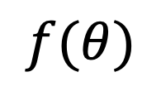


Variational Layer: Ansatz
$$\left|0\right\rangle$$
$$⋮$$
$$U(x)$$
$$V(θ)$$
$$M$$
$$O$$
$$\left|0\right\rangle$$
rotation layer
entangling layer
$$x_{1}→θ_{1}$$
$$RY\left(θ_{1}\right)$$
$$x_{2}→θ_{2}$$
$$RY\left(θ_{2}\right)$$
+
$$f(θ)$$
$$x_{3}→θ_{3}$$
+
$$RY\left(θ_{3}\right)$$
Notes:
The trainable part of the quantum circuit, called the ansatz, is commonly built from two sublayers.
The first is the rotation sublayer, which applies parameterized quantum gates whose rotation angles are adjusted during training.
The second is the entangling sublayer, which connects the qubits using controlled gates, allowing the circuit to represent more complex relationships in the data.
Together, these two sublayers form a variational block, and several such blocks can be repeated to create a more expressive model.
The ansatz produces an output that depends on its current parameters.
During training, these parameters are adjusted step by step so that the model output becomes closer to the expected result.
This process is repeated until the model reaches the desired level of performance.

Slide 16







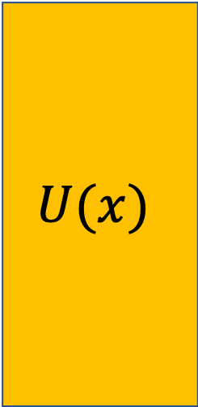





IBM’s Real Amplitudes Model
$$\left|0\right\rangle$$
$$⋮$$
$$U(x)$$
$$V(θ)$$
$$M$$
$$O$$
$$\left|0\right\rangle$$
Layer 1
Layer 2
$$U(x)$$
$$\left|0\right\rangle$$
$$RY\left(θ_{0}\right)$$
$$RY\left(θ_{3}\right)$$
$$RY\left(θ_{6}\right)$$
$$\left|0\right\rangle$$
$$RY\left(θ_{1}\right)$$
+
$$RY\left(θ_{4}\right)$$
+
$$RY\left(θ_{7}\right)$$
$$\left|0\right\rangle$$
+
+
$$RY\left(θ_{2}\right)$$
$$RY\left(θ_{5}\right)$$
$$RY\left(θ_{8}\right)$$
Notes:
The figure shows IBM’s RealAmplitudes ansatz, which uses adjustable parameters θ that are optimized during the training process. It is called RealAmplitudes because the circuit uses RY​ rotations and CX gates, which keep the amplitudes of the quantum state real-valued.
Once the feature vector has been encoded, the quantum state enters the trainable part of the circuit. The first layer applies an RY​ rotation to each qubit, with a different angle θi​. These angles are the variational parameters that are adjusted during training.
Next, CX gates entangle the qubits, allowing the circuit to create correlations between their states. In this example, the reverse-linear entanglement pattern connects the three qubits using two CX gates.
The sequence of rotation and entanglement layers is repeated twice, using different parameter values, and is followed by a final rotation layer. Repeating these layers increases the expressive power of the circuit, allowing it to represent more complex relationships in the data.

Slide 17
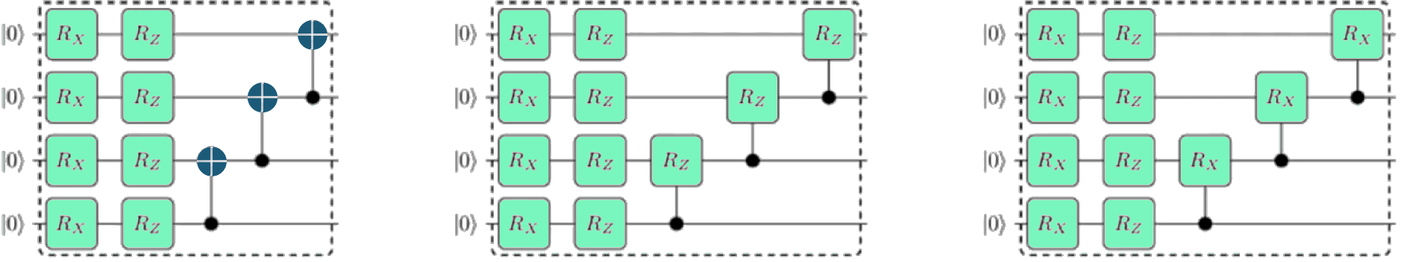
Examples of Variational Quantum Circuits
$$\left|0\right\rangle$$
$$⋮$$
$$U(x)$$
$$V(θ)$$
$$M$$
$$O$$
$$\left|0\right\rangle$$
Sim, S., Johnson, P.D. and Aspuru-Guzik, A. (2019),
Expressibility and Entangling Capability of Parameterized Quantum Circuits for Hybrid Quantum-Classical Algorithms.
Adv. Quantum Technol., 2: 1900070. https://doi.org/10.1002/qute.201900070
Notes:
The figure shows several additional examples of parameterized quantum circuits presented in the IBM paper cited below, which explored different circuit architectures for quantum machine learning.
All three circuits follow a similar structure. They begin with layers of parameterized RY​ and RZ​ rotations, followed by an entangling layer.
The main difference is the choice of gates used for entanglement. The first circuit uses cascading CX gates, while the other two use parameterized controlled rotations, CRZ​ and CRX​.
These examples illustrate that a variational quantum model does not have a single fixed architecture. Different combinations of rotation and entangling gates can be used to construct the trainable part of the model.
Reference
Sim, S., Johnson, P.D. and Aspuru-Guzik, A. (2019),
Expressibility and Entangling Capability of Parameterized Quantum Circuits for Hybrid Quantum-Classical Algorithms. Adv. Quantum Technol., 2: 1900070. https://doi.org/10.1002/qute.201900070

Slide 18
Entanglement Topologies
$$\left|0\right\rangle$$
$$⋮$$
$$U(x)$$
$$V(θ)$$
$$M$$
$$O$$
$$\left|0\right\rangle$$
star topology
linear topology
full topology
Notes:
In addition to choosing the type of entangling gates, these gates can be arranged using different entanglement topologies, which determine how the qubits are connected.
Star topology: One qubit acts as a central hub and is entangled with all the others. This provides connectivity between the central qubit and the rest of the register using relatively few entangling gates.
Linear topology: Each qubit is entangled with its nearest neighbor, forming a chain-like structure. This requires relatively few connections and can be well suited to hardware with limited qubit connectivity.
Fully connected topology: Every pair of qubits is connected through entangling gates. This provides richer interactions between qubits but requires more gates, increasing circuit complexity and potentially introducing more noise.
Reference
Sim, S., Johnson, P.D. and Aspuru-Guzik, A. (2019),
Expressibility and Entangling Capability of Parameterized Quantum Circuits for Hybrid Quantum-Classical Algorithms. Adv. Quantum Technol., 2: 1900070. https://doi.org/10.1002/qute.201900070

Slide 19


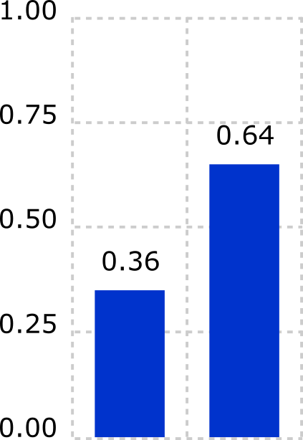
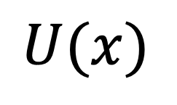





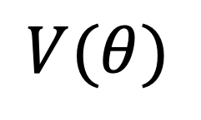
Measurement and Readout in VQC
$$\left|0\right\rangle$$
$$⋮$$
$$U(x)$$
$$V(θ)$$
$$M$$
$$O$$
$$\left|0\right\rangle$$
$$\left|0\right\rangle$$
$$y$$
0.88
$$\left|0\right\rangle$$
$$\left|0\right\rangle$$
$$U(x)$$
$$V(θ)$$
.
.
.
0.12
$$\left|0\right\rangle$$
class y: 0 1
Notes:
The next step in a variational quantum circuit (VQC) is measurement, or readout. Because quantum measurements are probabilistic, the circuit is typically executed many times (shots) to collect statistics. The results can be visualized as a histogram showing how frequently each measurement outcome occurs.
In a discriminative model, the measurement results are interpreted to produce a predicted class label or numerical value.
For example, the most probable bit or bitstring, such as “1” or “01”, can be mapped to a particular class..
In a generative model, the measurement results represent a probability distribution over possible outcomes.
For example, the complete probability distribution, such as {0:0.12, 1:0.88}.
The figure shows a simple binary quantum classifier that distinguishes between two classes, 0 and 1. In this case, measuring a single qubit is sufficient to determine the predicted class.

Slide 20

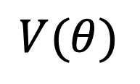

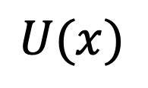


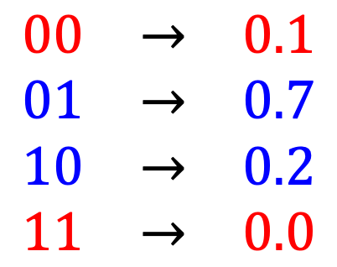
Parity Classification
$$\left|0\right\rangle$$
$$⋮$$
$$U(x)$$
$$V(θ)$$
$$M$$
$$O$$
$$\left|0\right\rangle$$
$$\begin{matrix}00 & → & 0.1 \\ 01 & → & 0.7 \\ 10 & → & 0.2 \\ 11 & → & 0.0\end{matrix}$$
$$\left|0\right\rangle$$
$$U(x)$$
$$V(θ)$$
$$\left|0\right\rangle$$
even: class 0
$$p_{0}=0.1+0.0=0.1$$
odd: class 1
$$p_{1}=0.7+0.2=0.9$$
Notes:
In quantum classifiers, an alternative strategy for determining the class label is parity-based post-processing, also called parity classification.
Suppose the measurement outcomes are:
00 with probability 0.1
01 with probability 0.7
10 with probability 0.2
11 with probability 0.0
The outcomes are grouped into two classes according to their parity, determined by whether the bitstring contains an even or odd number of 1s. The probabilities of all outcomes belonging to the same class are then added together.
In this example:
Class 0 (even parity): 00,11, $p_{0}=0.1+0.0=0.1$
Class 1 (odd parity): 01,10, $p_{1}=0.7+0.2=0.9$
Since Class 1 has the higher total probability, the model predicts Class 1 for the input.

Slide 21






Generative QML - Quantum Circuit Born Machine
$$\left|0\right\rangle$$
$$⋮$$
$$U(x)$$
$$V(θ)$$
$$M$$
$$O$$
$$\left|0\right\rangle$$
$$RY\left(x_{0}\right)$$
$$RY\left(θ_{0}\right)$$
$$RY\left(x_{1}\right)$$
$$RY\left(θ_{1}\right)$$
+
$$RY\left(x_{2}\right)$$
$$RY\left(θ_{2}\right)$$
+
QCBM
probability distribution
Notes:
A Quantum Circuit Born Machine (QCBM) is a generative quantum machine learning model in which the probability distribution produced by a parameterized quantum circuit is trained to approximate a target distribution.
Unlike a classifier, a QCBM learns a probability distribution and generates samples that resemble the training data. The figure shows a parameterized quantum circuit whose parameters are optimized to reproduce the target distribution.
Quantum circuits are naturally suited to this task because measuring a quantum state inherently produces samples from a probability distribution. which states that the probability of measuring a particular quantum state is given by the squared magnitude of its amplitude.
During training, the parameters $θ$ are adjusted so that the distribution $p_{θ}\left(x\right)$ becomes as close as possible to the target distribution. Once trained, the QCBM can generate new samples with statistical properties similar to those of the training data. This makes QCBMs useful for generative tasks and for modeling complex probability distributions.

Slide 22

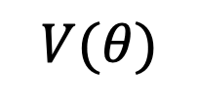
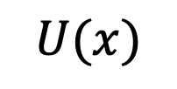




Training a Variational Quantum Model
$$\left|0\right\rangle$$
$$⋮$$
$$U(x)$$
$$V(θ)$$
$$M$$
$$O$$
$$\left|0\right\rangle$$
Input: $x$
$$θ_{0}$$
classical optimization
$$\left|0\right\rangle$$
$$U(x)$$
$$V(θ)$$
loss
function
ansatz
optimizer
$$\left|0\right\rangle$$
encoding
layer
variational
layer
meas.
layer
update $θ$
Notes:
Variational quantum models are typically trained via an iterative optimization loop:
Start with input data $x$ and initial parameters θ.
Run the quantum circuit multiple times to obtain its output.
Compare the circuit output with the expected output using a loss function.
The classical optimizer uses the loss to update the parameters θ in the direction that minimizes the loss.
Run the circuit again with the updated parameters and repeat the process until the loss is minimized.

Slide 23
The Optimization Loop in VQC
Notes:
This diagram shows the optimization loop in a variational quantum circuit. The process starts with a set of circuit parameters. The circuit is executed with these parameters, and measurement gives a probability distribution. The loss function then compares this distribution with the desired distribution and produces a single value, called the loss. The optimizer uses this loss to suggest a new set of parameters that should reduce it. The circuit is then executed again with the new parameters, and the whole process repeats. The goal is to make the loss as small as possible, meaning that the output distribution becomes as close as possible to the desired distribution.

Slide 24
Quantum-Native AI
intelligence emerges from quantum processes
Notes:
Quantum-native AI goes beyond simply using quantum computers to improve computational performance. The idea is that quantum processes themselves become part of how an intelligent system learns and makes decisions.

Slide 25
Quantum AI Roadmap
2026
2027
2030
2040
2050
Hybrid
Native Quantum
Quantum
Cognition
QAGI
QSI
The model runs on a quantum computer, but the optimization is classical.
All stages, from data encoding, processing, and optimization take place within quantum systems.
Treats cognition as a quantum process, opening new ways to model reasoning.
A theoretical horizon where learning, cognition, and possibly awareness arise from quantum processes.
Quantum-powered superintelligence that goes far beyond human abilities.
Notes:
Today, most AI models are hybrid: they run on a quantum computer, but the optimization is classical.
At the same time, research efforts are increasing toward native quantum models, where all stages of data encoding, processing, and optimization take place within quantum systems.
The next step is Quantum Cognition, which treats cognition as a quantum process, opening new ways to model reasoning.
Quantum Artificial General Intelligence represents a theoretical horizon where learning, cognition, and possibly awareness arise from quantum processes.
A form of quantum intelligence so advanced that it could uncover truths, make discoveries, and solve challenges far beyond what any human mind can imagine.

Slide 26
Gödel and the Question of AGI
Gödel's incompleteness theorems (1931)
Any formal system capable of basic arithmetic contains true statements it cannot prove.
Example: This statement is false.
No such system can prove its own consistency.
Example: A map can’t verify its own accuracy.
In any consistent formal system that is sufficiently expressive to include basic arithmetic, there exist true statements about natural numbers that cannot be proven within the system itself.
No consistent formal system that is sufficiently expressive to include basic arithmetic can prove its own consistency.
All formal systems, including programming languages and classical AI models, have built-in limits.
“Either mathematics is too big for the human mind or the human mind is more than a machine.
Kurt Gödel (1906—1978)
For true AGI, we may need inputs that lie outside classical logic — possibly using quantum processes.
Notes:
The mainstream view view is that intelligence emerges from complex neural networks, so AGI might be achieved by building machines that can simulate them. But not everyone agrees, saying this approach has built-in limits, citing Gödel’s incompleteness theorems.
In simple terms, the first Gödel’s theorem state that any formal system capable of basic arithmetic contains true statements it cannot prove. The simplest illustration in everyday language is the sentence: “This statement is false.”
The second theorem says that no such system can prove its own consistency. For example, A map can’t verify its own accuracy. You need another map, or some higher-level authority, to verify it.
From a computer science perspective, Gödel’s theorems suggest that all formal systems, including programming languages and Classical AI models, have inherent limits. Even a perfect classical AGI could never fully understand itself.
For true AGI, we may need input that lies outside classical logic. Possibly something that arises from quantum processes, which behave in probabilistic, contextual, and entangled ways.
Reference:
K. Gödel, “Über formal unentscheidbare Sätze der Principia Mathematica und verwandter Systeme I,” Monatshefte für Mathematik und Physik, vol. 38, pp. 173–198, 1931.
(On Formally Undecidable Propositions of Principia Mathematica and Related Systems I.)

Slide 27




Penrose Hameroff: Orchestrated Objective Reduction (Orch-OR)
tubulin
molecule
superposition
$$\left|0\right\rangle$$
space
$$\left|1\right\rangle$$
Roger Penrose
$$\left|0\right\rangle +\left|1\right\rangle$$
time
microtubule
(cell cytoskeleton)
objective
reduction
$$t≈25ms$$
Stuart Hameroff
Classical view
Orch-OR view
Brain power comes from neurons: ~10¹⁶ ops/sec.
Brain power comes from tubulin: ~10²⁷ ops/sec.
Stuart R. Hameroff, Roger Penrose, Consciousness in the universe: A review of the ‘Orch OR’ theory, Physics of Life Reviews 11: 39-78, 2014
Notes:
To address the proposed limitations of classical computation in explaining human reasoning, Penrose and Hameroff developed a quantum-based theory of consciousness called Orchestrated Objective Reduction, or Orch-OR. According to their theory, consciousness arises not only from a neural complexity, but from tiny structures inside neurons called microtubules. Microtubules are made of tubulin molecules that can act like qubits, capable of being in two states or a superposition of both.
Penrose explains superposition as two diverging curvatures of spacetime. When the separation between these spacetime states becomes large enough, the quantum state collapses on its own. Penrose called this process Objective Reduction (OR) and estimated that it occurs roughly every 25 milliseconds. This timescale aligns with the brain’s ~40 Hz gamma oscillations often associated with conscious awareness.
In this view, the brain’s computational power is not limited by the number of neurons, but by the enormous number of tubulin molecules within them. Instead of around 10¹⁶ operations per second, the brain could potentially achieve ~10²⁷ operations per second — far beyond the capability of classical simulation.
References:
Stuart R. Hameroff, Roger Penrose, “Consciousness in the universe: A review of the ‘Orch OR’ theory,” Physics of Life Reviews 11: 39-78, 2014, doi: 10.1016/j.plrev.2013.08.002.

Slide 28
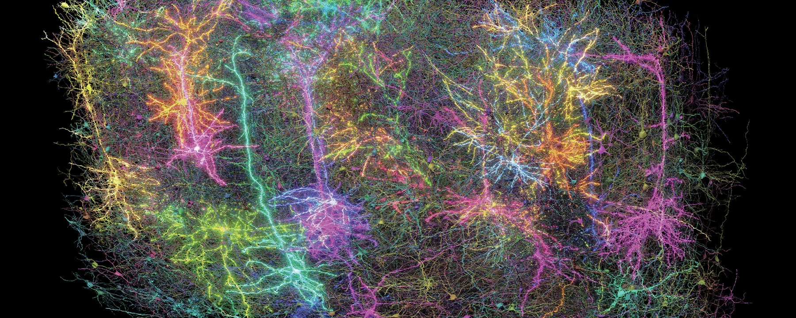
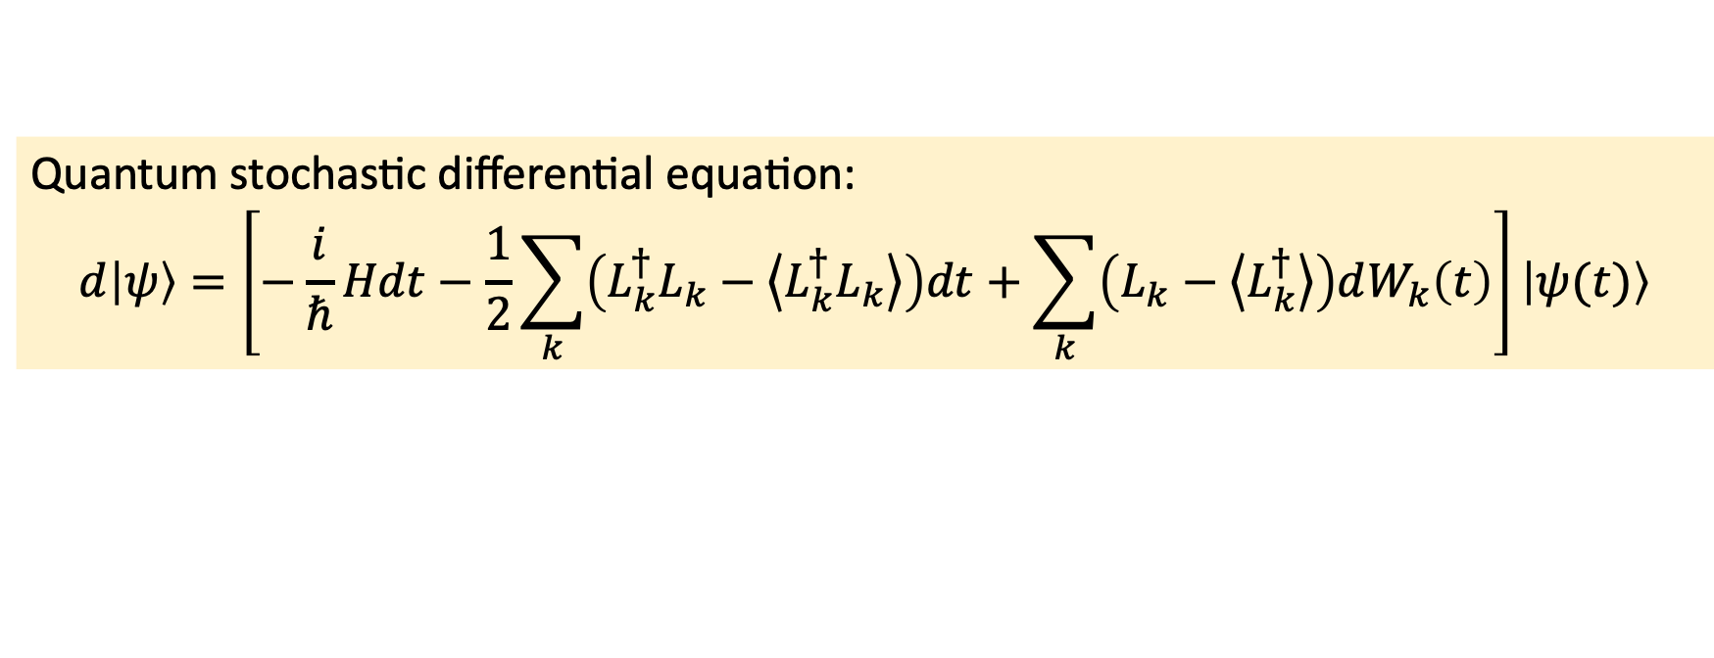
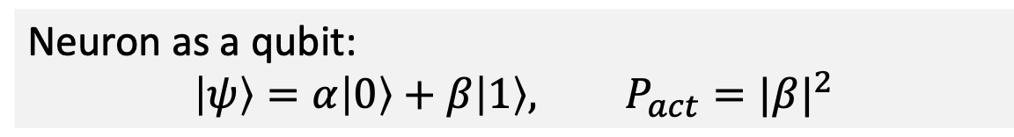
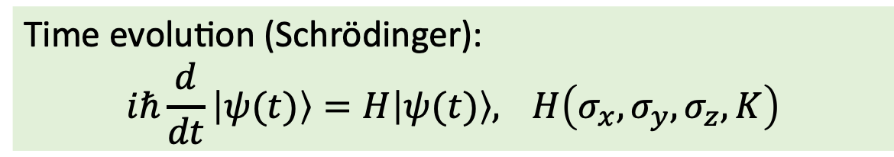
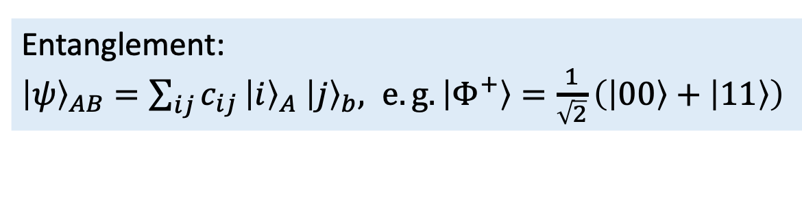
A Stochastic Quantum Neural Network Model for AI (QNNS)
Neuron as a qubit:
$$\left|ψ\right\rangle =α\left|0\right\rangle +β\left|1\right\rangle , P_{act}={|β|}^{2}$$
Entanglement:
${\left|ψ\right\rangle }_{AB}=\sum_{ij}{c_{ij}}{\left|i\right\rangle }_{A}$ ${\left|j\right\rangle }_{b}, e.g.\left|Φ^{+}\right\rangle =\frac{1}{\sqrt{2}}\left(\left|00\right\rangle +\left|11\right\rangle \right)$
G.-E. Filardo and T. Heckmann, “A stochastic quantum
neural network model for AI,” arXiv preprint
arXiv:2511.11609, Nov. 2025.
Time evolution (Schrödinger):
$$iℏ\frac{d}{dt}\left|ψ(t)\right\rangle =H\left|ψ(t)\right\rangle , H\left(σ_{x},σ_{y},σ_{z},K\right)$$
Quantum stochastic differential equation:
$$d\left|ψ\right\rangle =\left[−\frac{i}{ℏ}Hdt−\frac{1}{2}\sum_{k}{\left(L_{k}^{†}L_{k}−\left\langle \left.L_{k}^{†}L_{k}\right\rangle \right.\right)dt}+\sum_{k}{\left(L_{k}−\left\langle \left.L_{k}^{†}\right\rangle \right.\right)dW_{k}\left(t\right)}\right]\left|ψ(t)\right\rangle$$
Notes:
The Penrose–Hameroff model remains difficult to test experimentally, but researchers are beginning to explore quantum-based models of neural processing. One example is the “Stochastic Quantum Neural Network Model.” In this model, each neuron is represented by a qubit in superposition, and neural activation is defined as the probability of measuring the qubit in the state ∣1⟩.
To capture correlations between quantum neurons, the authors use entanglement. This allows different neurons to influence one another in ways that go beyond classical connectivity.
The temporal evolution of an isolated quantum neural network follows the Schrödinger equation. The operator that drives this evolution is built from rotation operators, together with a coupling term that determines how the neurons interact.
The authors formulated a stochastic equation that captures the evolution of a quantum system under environmental influence. The first term describes standard Schrödinger evolution. The second models the environment’s effect. The third adds random fluctuations similar to those in biological neurons.
Although this model is a step closer to possible implementation, it remains fully theoretical and cannot be built on today’s quantum hardware.
=========
The Hamiltonian is a Hermitian matrix that encodes the energy of the system and dictates how the quantum state evolves in time. For a single qubit, a Hamiltonian might be a combination of Pauli matrices, such as: H=aX+bY+cZ
The Planck constant links a particle’s energy to its frequency as E=hf. ($ℏ$=h/2pi – reduced planck constant)
$L_{k}$ is Lindblad operator is a matrix that describes how the environment disturbs the quantum state. $dW_{k}\left(t\right)$ is a Wiener increment — the mathematical representation of a tiny random fluctuation, used to model noise in the quantum system. Simply, it is a random number drawn from a Gaussian (normal) distribution..
=========

Slide 29
Quantum Cognitive Models
Applying quantum phenomena to thinking and decision-making processes.
IBM QUATRO
Maps cognitive models directly to quantum hardware, using variational quantum circuits. First to execute cognition models on real quantum devices.
IonQ
IonQ implemented quantum circuits for human-cognition models on trapped-ion hardware.
Quantum-Cognitive
Neural Networks
Quantum-inspired models that apply principles of superposition, interference, and contextual probability to model perception, judgment, and decision-making.
Notes:
Another stream of research, called Quantum Cognitive Models, takes a different approach. They focus on the principles of cognition rather than the biological or physical processes of the brain. These models apply quantum phenomena quantum phenomena to thinking and decision-making processes.
Some projects include:
IBM’s QUATRO and IonQ: uses variational quantum circuits to simulate quantum-inspired cognitive models on real hardware.
Another promising direction is Quantum-Cognitive Neural Networks, which use quantum principles to model perception, judgment, and decision-making. These models have shown practical value in ambiguous tasks like telling apart different types of oranges in transparent plastic bags, and distinguishing military from civilian vehicles of the same make.
They excel at ambiguous tasks, like spotting items through transparent plastic bags or distinguishing a civilian truck from its military version. For now, they run on classical computers because the required quantum hardware doesn’t exist yet.

Slide 30
The Final Frontier: Quantum Superintelligence
True superintelligence would need more than computational power. It would require awareness, understanding, and perhaps entirely new forms of cognition, far beyond what today’s AI can achieve.
Quantum superintelligence (QSI) would be a self-aware intelligence far beyond the best human abilities, powered by quantum technologies.
Notes:
The final frontier would be quantum superintelligence.
True superintelligence would require not just computational power. It would require qualities like awareness and understanding, things today’s AI does not have.
Quantum superintelligence (QSI ) would be a self-aware intelligence far beyond the best human abilities, powered by quantum technologies.
It may be the last machine we ever build.

Slide 31

Questions?

